Slide 1
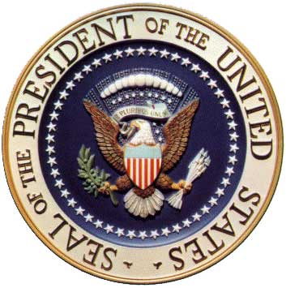

Barack Obama

Slide 2
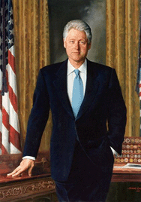
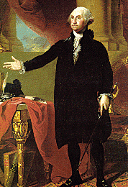
president
A person who is elected to have authority or control over a group of people.

Slide 3
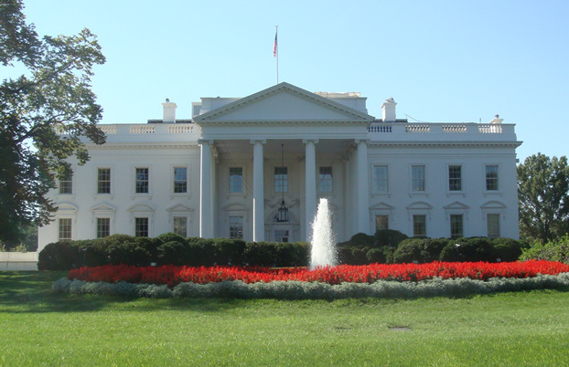
White House
The executive mansion of the President of the United States. This is where the President lives and works.

Slide 4
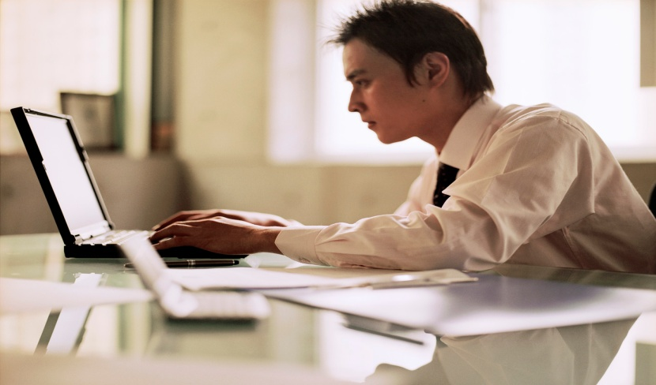
work
An activity you do that you produce or accomplish something.
Jackson had to work hard on his science project.
My mom had to go to work at the hospital yesterday.

Slide 5
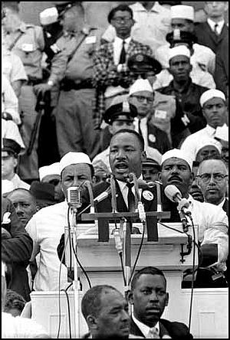
speech
Talking to a large group of people. Who is giving this speech?
Martin Luther King Jr.

Slide 6
promise
When someone says that they will or will not do something.

Slide 7
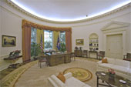
Oval Office
The Oval Office is the president's formal workspace.
This is where he often addresses the American public and the world on television or radio.
Where the president deals with the issues of the day.

Slide 8
Washington D.C.
Our nation’s capital.
We went to Washington D.C. and saw the White House and the Washington Monument.

Slide 9
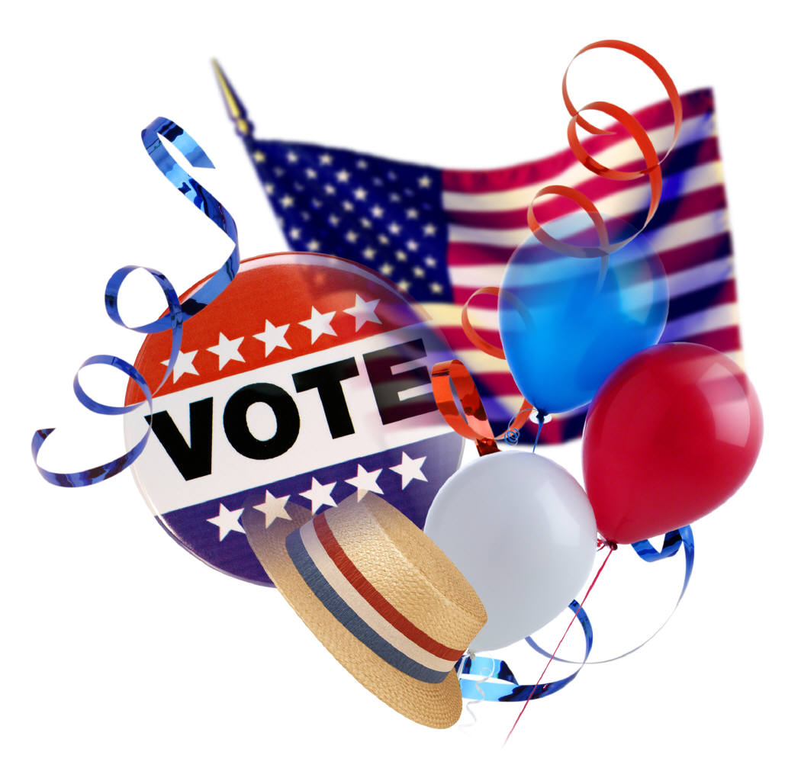
election
The right or ability to make a choice.

Slide 10
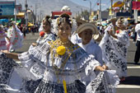
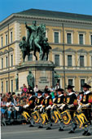
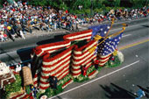

parade
An organized public procession on a festive or ceremonial occasion.

Slide 11
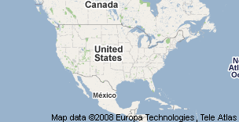
United States
The country we live in that consists of the 50 states.

Slide 12
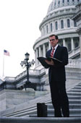
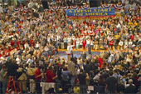
senator
A person who works for the government that helps to make and create laws.
Barack Obama was a senator.

Slide 13
inauguration
Formal induction into office. A formal beginning or introduction.
Every president has an inauguration into the Presidency.

Slide 14
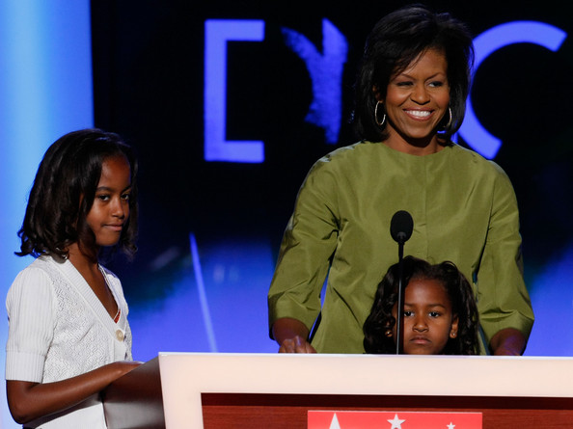
Michelle Obama
Barack Obama’s wife.

Slide 15

January 20, 2009
The date of the inauguration

Slide 16
laws
A rule of conduct or procedure established by custom, agreement, or authority.

Slide 17


flag
A piece of cloth, usually rectangular, of distinctive color and design, used as a symbol.

Slide 18
leader
Someone in charge that you may listen to or follow them.

Slide 19
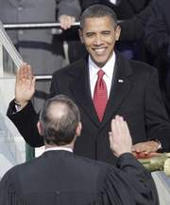
oath
A solemn, formal declaration or promise to fulfill a pledge

Slide 20
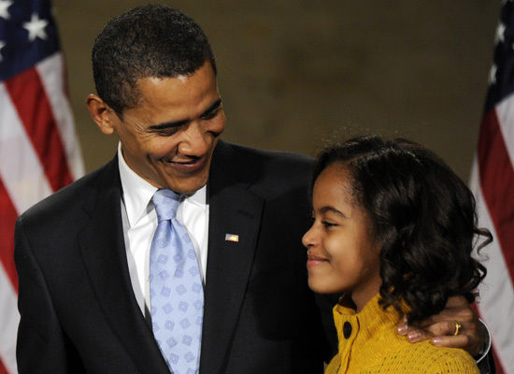
Malia Obama
Barack Obama’s daughter. She is in the 5th grade.

Slide 21
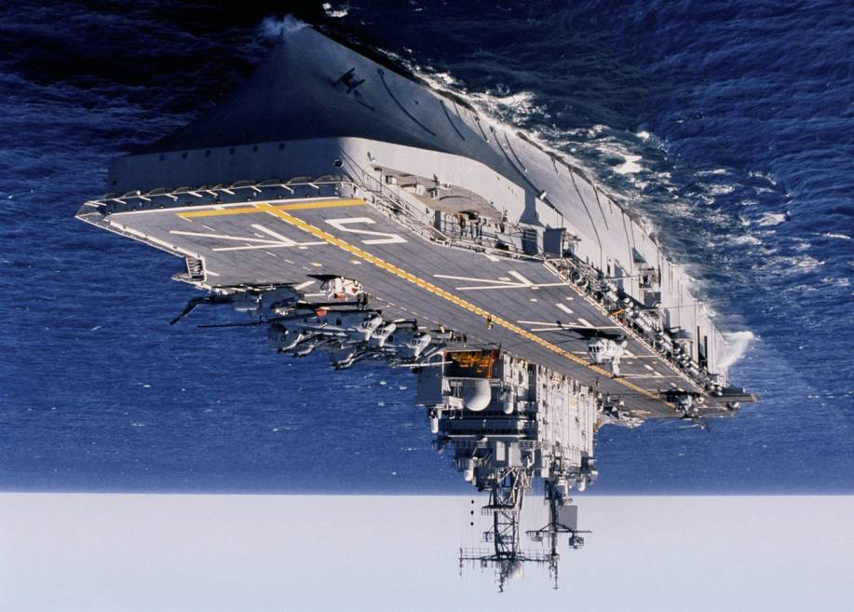
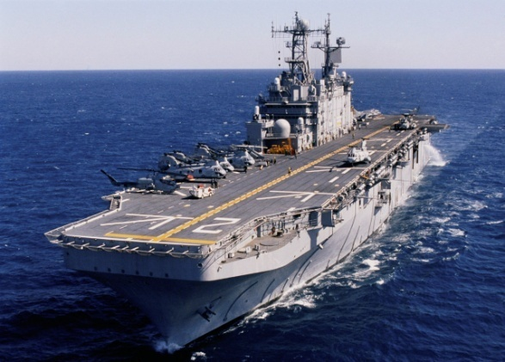
Armed forces
Army
Navy
Air Force
Marines

Slide 22
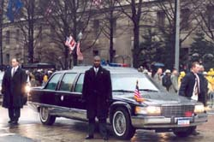
Secret service
People hired to protect the President at all times.

Slide 23
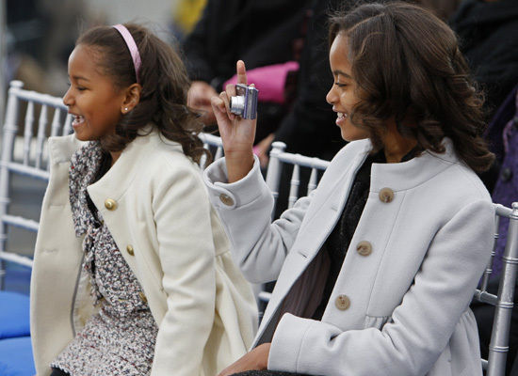
Sasha Obama
Barack Obama’s youngest daughter. She is in the 2nd grade.

Slide 24
protect
To keep away from danger or harm
My mom and dad always protect me by holding my hand when I cross the street.

Slide 25
